Slide 1
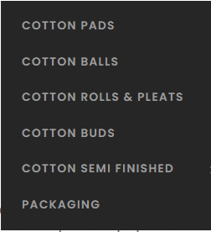
WE BUY 1000 TONS OF CORRUGATED CARTONS PER YEAR

Slide 2
2018 MAJOR ODOUR INCIDENT
0 EXPORT CONTAINER REJECTED OVERSEAS.
0 VOMITTING ODOUR IN OUR COTTON PRODUCTS.
0 COTTON PRODUCTS PRIMARY PACKED IN LDPE BAGS.
0 SECONDARY PACKED IN KRAFT PAPER CARTONS.
0 ANALYSIS DONE WITH HELP OF IIP.
0 CONCLUDED ROOT CAUSE - KRAFT PAPER ODOUR.

Slide 3
ODOUR
REASONS
Paper Quality
Mill Location
Gum Quality
Moisture percentage
Drying time
Aeration in storage
In-transit conditions
IN KRAFT PAPER CORRUGATED CARTONS
PASSES EASILY TO ABSORBENT COTTON
CAUSING FOUL SMELL IN FINAL PRODUCTS

Slide 4
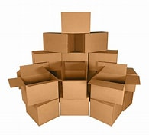
COMPLAINTS
0 ARISE MOSTLY IN MONSOON SEASONS.
0 IN CARTONS WITH ALL PLYS OF KRAFT PAPER

Slide 5
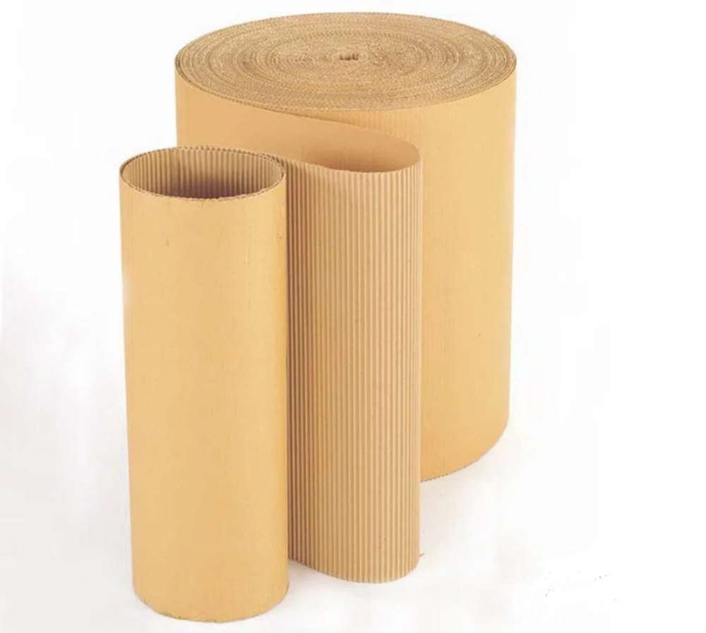
QUALITY MATTERS
0 HIGH LOCAL WASTE USED IN LOW BF PAPER
0 RECYCLED PROCESS WATER CONTROL
0 MILL LOCATION

Slide 6
ODOUR FREE
0 USING HIGH QUALITY WASTE
0 PROCESS WATER QUALITY CHECK
0 OTHER INGREDIENTS ODOUR
0 CONTROL MOISTURE LEVEL
0 PROPER AEARATION IN STORAGE

Slide 7
