Slide 1
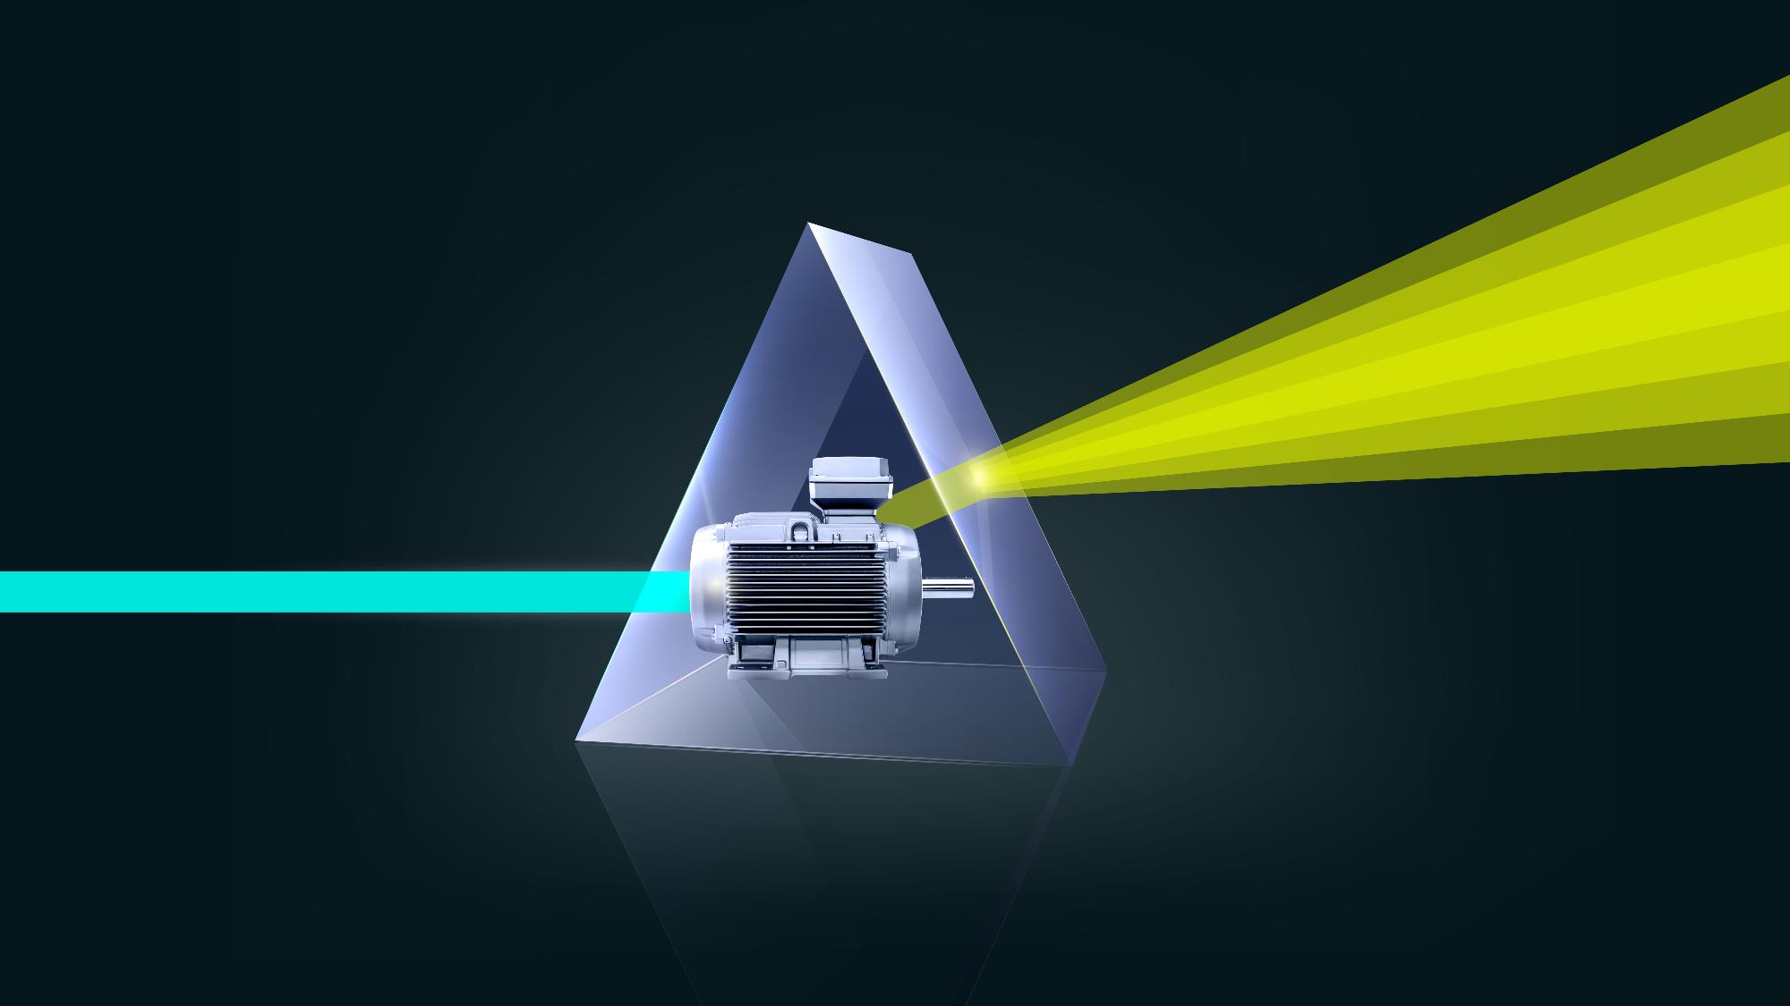
SIEMENS
INNOMOTICS

Slide 2

Sustainability through High Efficiency LV Motors in Paper Industry
Siemens’ commitment towards it

Slide 3

Sustainability Development Goals

Slide 4
2 degrees increase…
…is a death sentence

Slide 5

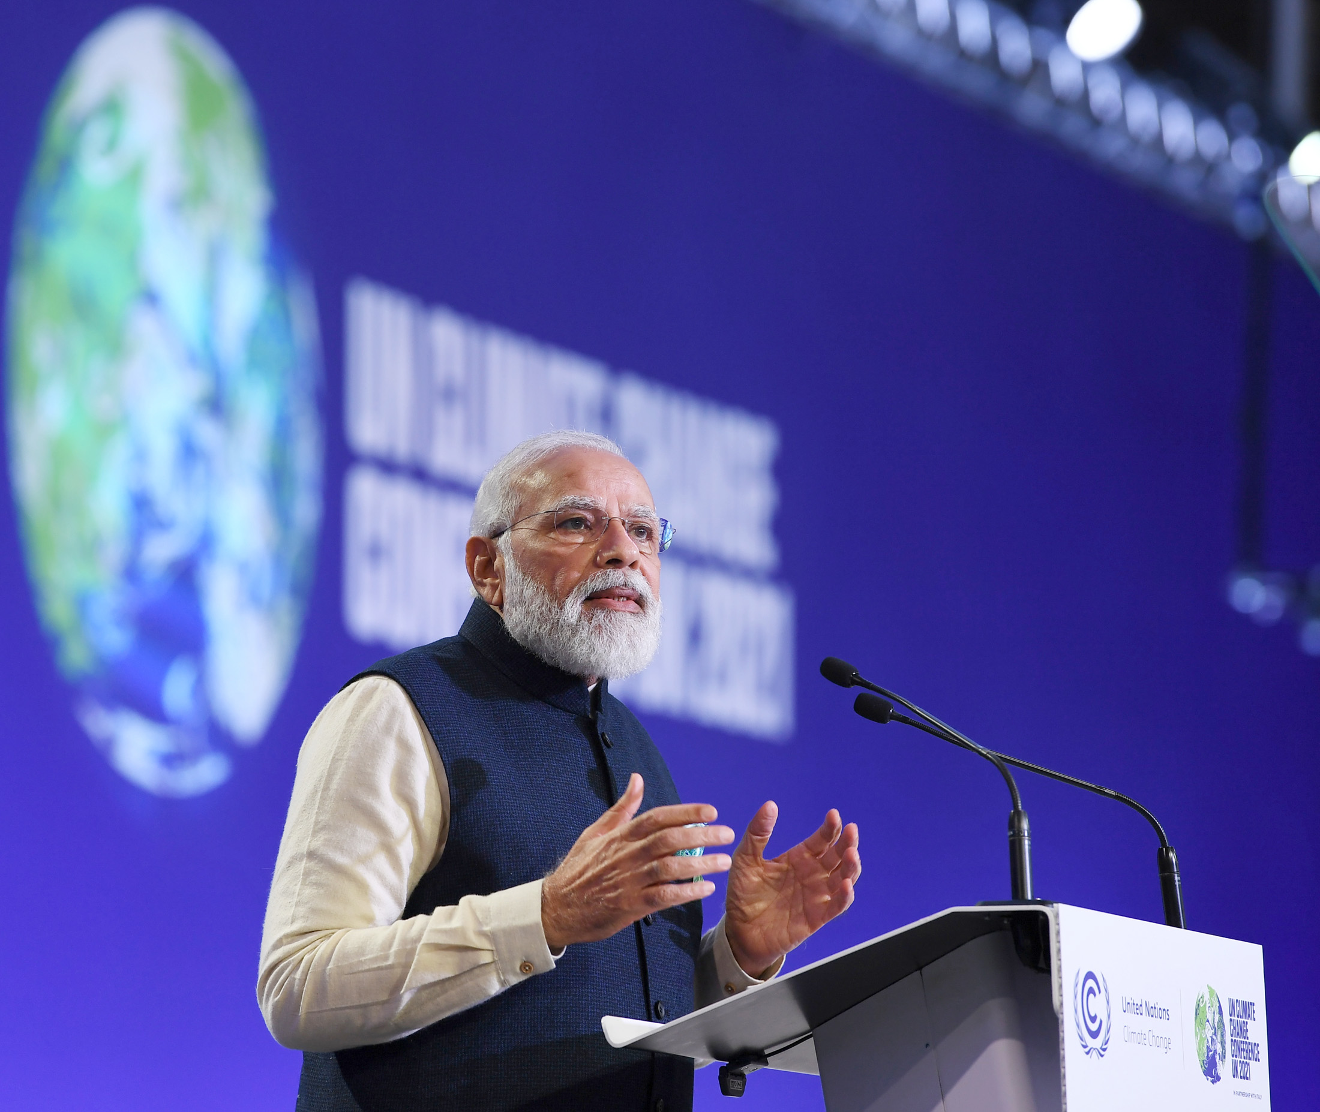
COP28 (Dubai) – India commits to net zero by 2070

Slide 6
Sustainability Development Goals related to LV Motors portfolio
Compliance on Hazardous Substance
High and Premium Efficiency motors
RoHS
(Restriction of Hazardous Substances
REACH
(Registration, Evaluation, Authorization
and Restriction of Chemicals)
Lead the industry on making and using high and premium efficiency motors
commitment to sustainability
Technical Awareness Sessions
True commitment towards high efficiency
Plant Auditing
Payback and environment impact estimation
Financial viability justification
Conformance to CE specific to tolerance

Slide 7
Sustainability Development Goals related to LV Motors portfolio
Compliance on Hazardous Substance
High and Premium Efficiency motors
RoHS
(Restriction of Hazardous Substances
REACH
(Registration, Evaluation, Authorization
and Restriction of Chemicals)
Lead the industry on making and using high and premium efficiency motors
commitment to sustainability
Technical Awareness Sessions
True commitment towards high efficiency
Plant Auditing
Payback and environment impact estimation
Financial viability justification
Conformance to CE specific to tolerance

Slide 8

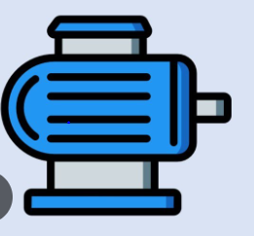
What do you think about cost of purchase and cost of usage?
230x
15 kW
Rs. 20L
Cost of Asset
Rs. 0.5L
1500 kms
Running per month
600 hrs (average in Paper Ind)
18,000 kms
Running per year
7,200 hrs
Rs. 10/-
Cost per unit
Rs. 10/-
Rs. 1.80L
Running cost per year
Rs. 11.88L (16.5 kWx7,200X10)
0.1
Running to Asset Ratio
23.76

Slide 9
World Ahead of India on MEPS
India
Europe
P_{n} [kW]
P_{n} [kW]
Stringent CE
1 000
1 000
IE3
2/4/6/8 Poles
200
IE4
IE3
2/4/6 Poles
IE2
75
IE3
2/4/6/8 Poles
2/4/6/8 Poles
2/4/6/8 Poles
0.75
IE2
IE2
2/4/6/8
2/4/6/8
Poles
Poles
0.12
0.12
1st January 2017
1st July 2021
1st July 2023
Even China has made IE3 MEPS and IE4 for new projects

Slide 10

High Efficiency Motors – A lever to Sustainability
Average Efficiency
Power consumption by 3 Ph. Safe area LV Motors sold in FY23 in India
CO₂ emission by 3 Ph. Safe area LV Motors sold in FY23 in India
P_{n} [kW]
TWh
TgC
23,18,000 Ton reduction
1 000
87% Eff
~ 13% loss
78.3
TWh
56.85
TgC
More than 9 Crore trees required in a year to absorb that CO₂
89% Eff
~ 11% loss
76.5 TWh
55.57 TgC
91% Eff
~ 9% loss
75.1 TWh
54.53 TgC
IE2
IE3
IE4
IE2
IE3
IE4
IE2
IE3
IE4
0.12
1 TWh = 10⁹ kWh
1 TgC = 10⁶ ton CO₂

Slide 11

Greener World

Slide 12
Case Study – 400 TPD Integrated Paper Mill
Value In Lacs
+97.6%
+887.8%
+1875.5%
839
Investment IE2 – 450 L
Investment IE3 - 492 L
Incremental Investment - 42 L
419
84
42
Total Power – 15.1 MW
Incremental Investment
Savings in a Year
Savings in 5 Years
Savings in 10 Years
Value In Lacs
+16.0%
+479.8%
+1059.7%
1634
Investment IE2 – 450 L
Investment IE4 - 591 L
Incremental Investment - 141 L
817
163
141
Incremental Investment
Savings in a Year
Savings in 5 Years
Savings in 10 Years

Slide 13
Case Study – 400 TPD Integrated Paper Mill
Annual Energy Saving (MWh)
Annual CO₂ reduction (Ton)
59,331
30,457
Total Power – 15.1 MW
Total Power – 15.1 MW
IE3 Vs IE2
IE4 Vs IE2
IE3 Vs IE2
IE4 Vs IE2
Payback Period for
Incremental investment (Months)
IE3 Vs IE2
IE4 Vs IE2

Slide 14
Case Study – 150 TPD waste paper based mill
Value In Lacs
+69.2%
+746.2%
+1592.3%
220
Investment IE2 – 118 L
Investment IE3 - 131 L
Incremental Investment - 13 L
110
22
13
Total Power – 3.7 MW
Incremental Investment
Savings in a Year
Savings in 5 Years
Savings in 10 Years
Value In Lacs
+4.9%
+424.4%
+948.8%
430
Investment IE2 – 118 L
Investment IE4 - 159 L
Incremental Investment - 41 L
215
43
41
Incremental Investment
Savings in a Year
Savings in 5 Years
Savings in 10 Years

Slide 15
Case Study – 150 TPD Waste Paper based mill
Annual Energy Saving (MWh)
Annual CO₂ reduction (Ton)
15,585
8,075
Total Power – 3.7 MW
IE3 Vs IE2
IE4 Vs IE2
IE3 Vs IE2
IE4 Vs IE2
Payback Period for
Incremental investment (Months)
IE3 Vs IE2
IE4 Vs IE2

Slide 16
IE4 motor reduces carbon emission and increases the saving.

Slide 17
Sustainability Development Goals related to LV Motors portfolio
Compliance on Hazardous Substance
High and Premium Efficiency motors
RoHS
(Restriction of Hazardous Substances
REACH
(Registration, Evaluation, Authorization
and Restriction of Chemicals)
Lead the industry on making and using high and premium efficiency motors
commitment to sustainability
Technical Awareness Sessions
True commitment towards high efficiency
Plant Auditing
Payback and environment impact estimation
Financial viability justification
Conformance to CE specific to tolerance

Slide 18

Why???

Slide 19
Testing
η
Seeing is believing
means
TRUE

Slide 20
Sustainability Development Goals related to LV Motors portfolio
Compliance on Hazardous Substance
High and Premium Efficiency motors
RoHS
(Restriction of Hazardous Substances
REACH
(Registration, Evaluation, Authorization
and Restriction of Chemicals)
Lead the industry on making and using high and premium efficiency motors
commitment to sustainability
Technical Awareness Sessions
True commitment towards high efficiency
Plant Auditing
Payback and environment impact estimation
Financial viability justification
Conformance to CE specific to tolerance

Slide 21
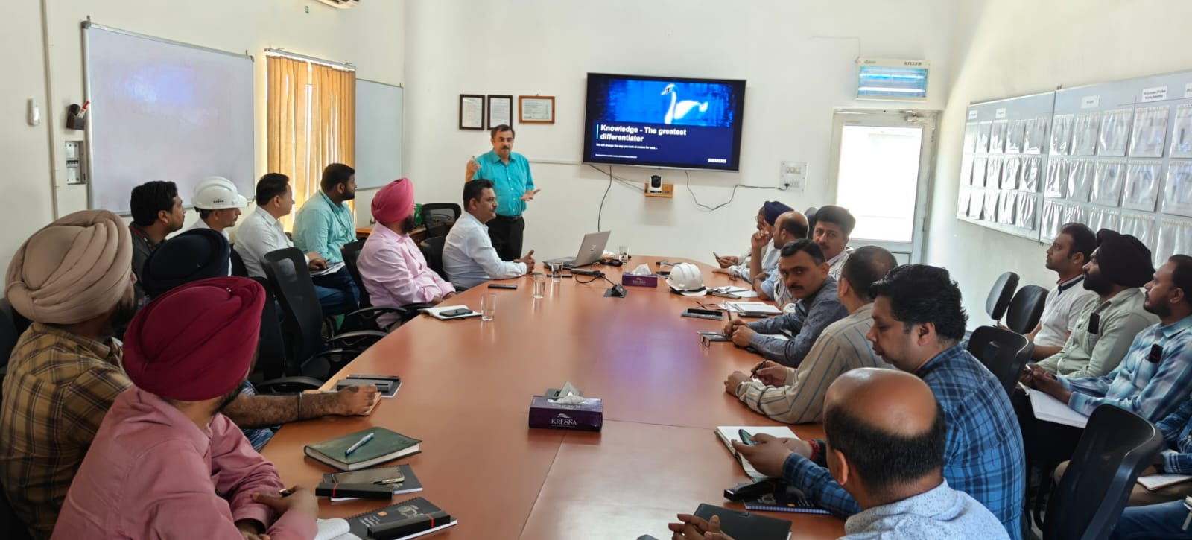
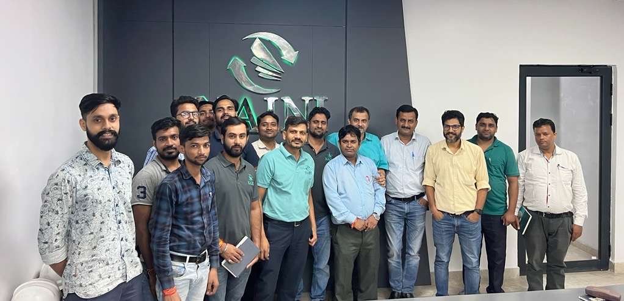
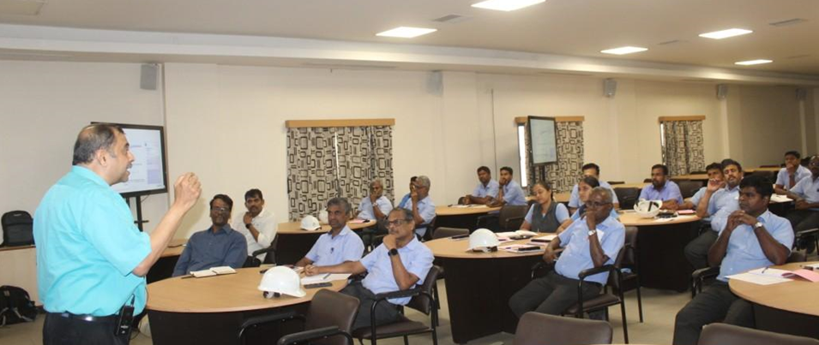
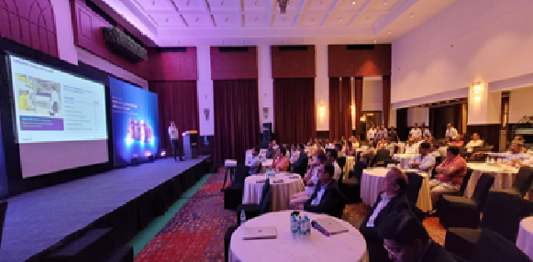
Technical Awareness – Some Events successfully conducted
Kuantum Paper
Naini Paper
Seshasayee Paper And Boards Ltd. Erode
Paper Industry Seminar, Muzaffarnagar

Slide 22
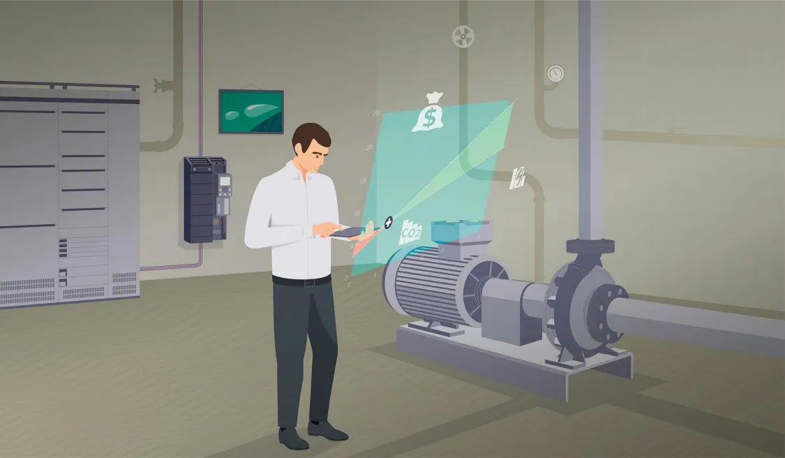

SinaSave
www.sinasave.siemens.com

Slide 23
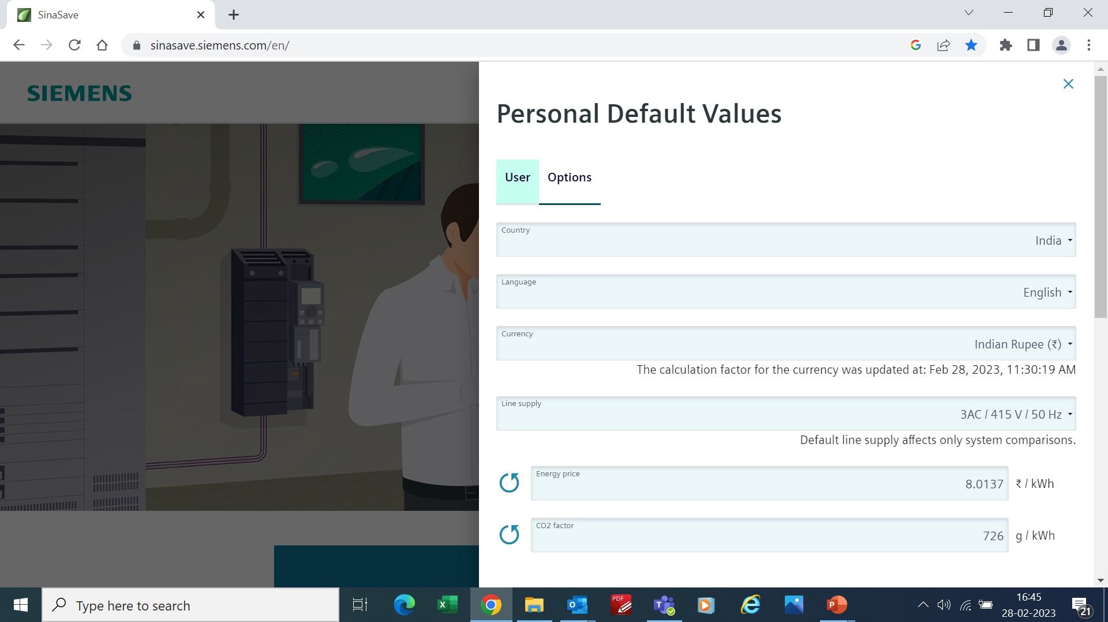
Payback Report

Slide 24
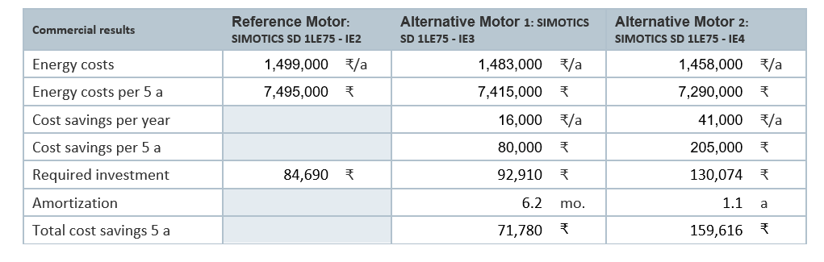
Payback Report

Slide 25
Sustainability Development Goals related to LV Motors portfolio
Compliance on Hazardous Substance
High and Premium Efficiency motors
RoHS
(Restriction of Hazardous Substances
REACH
(Registration, Evaluation, Authorization
and Restriction of Chemicals)
Lead the industry on making and using high and premium efficiency motors
commitment to sustainability
Technical Awareness Sessions
True commitment towards high efficiency
Plant Auditing
Payback and environment impact estimation
Financial viability justification
Conformance to CE specific to tolerance

Slide 26
UNITE. ACT. DELIVER.

Slide 27
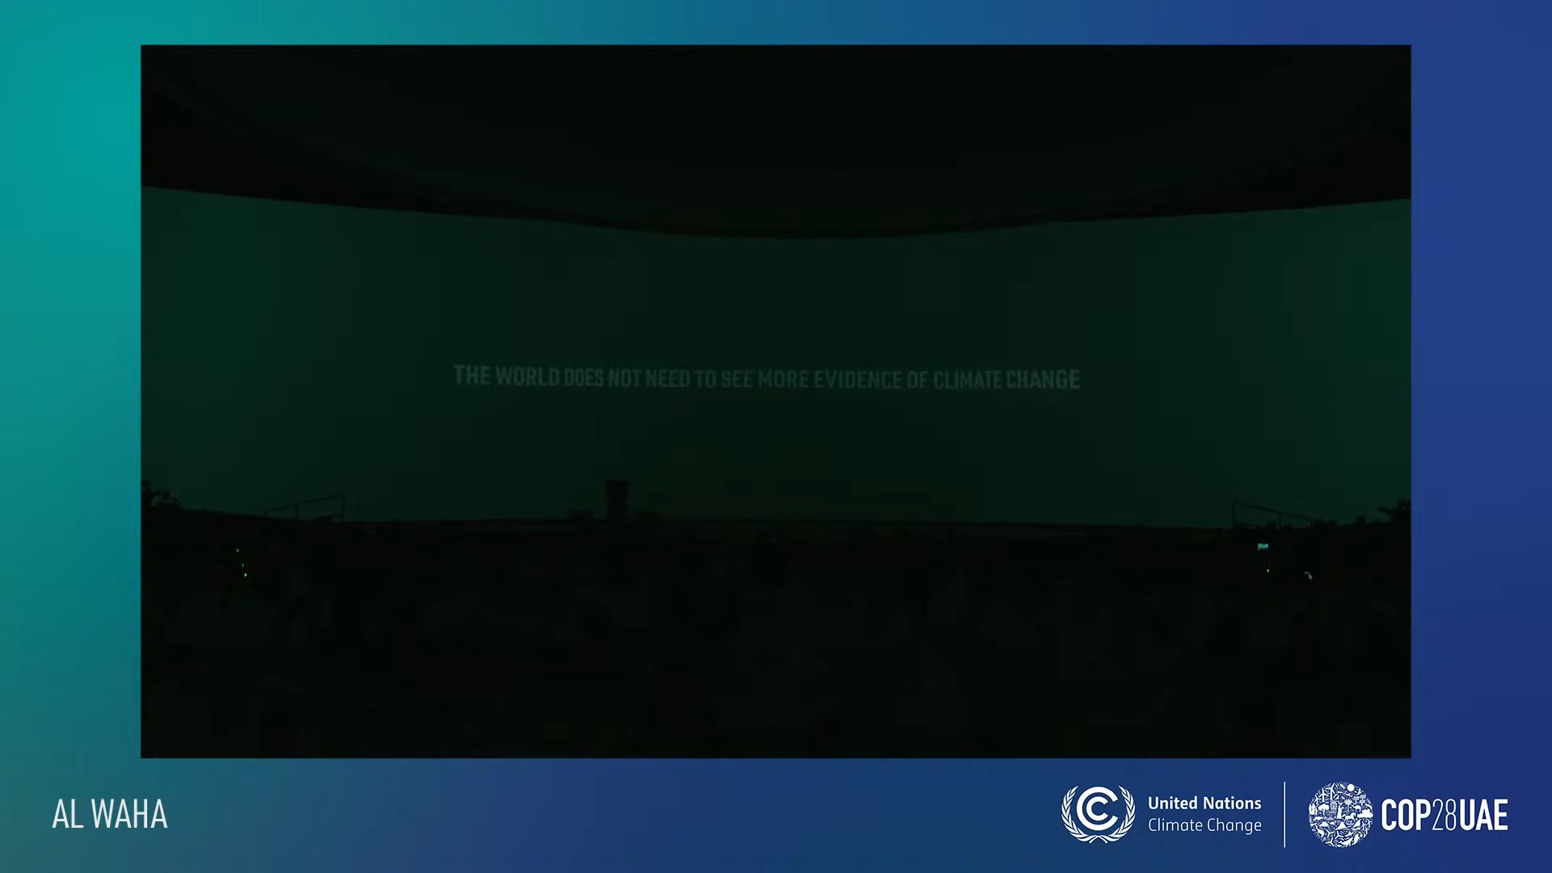
Restricted | Alpesh | Siemens POC- LV-Motors |

Slide 28


Slide 29
Contact
Published by Siemens 2024
  Alpesh Mehta
  Head - LV Motors
Siemens Ltd.
6th Floor, R&D Tech Center, Thane Belapur Road, Airoli Node,
NAVI MUMBAI - 400 708
INDIA
  E-mail: alpesh.mehta@siemens.com

