Slide 1
Status of Paper Industry
Dr. B. P. Thapliyal, Director
CENTRAL PULP AND PAPER RESEARCH INSTITUTE, SAHARANPUR

Slide 2
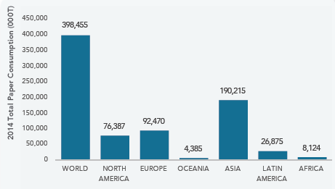
Global Paper Consumption (by region)
408,000 (2018)
Source: FAO, 2016

Slide 3
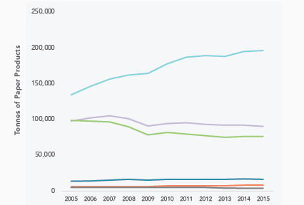
Region-wise shift in Paper Consumption (2005-15)
Asia
Europe
N America
S America
Africa & Ocenia
Source- FAO

Slide 4
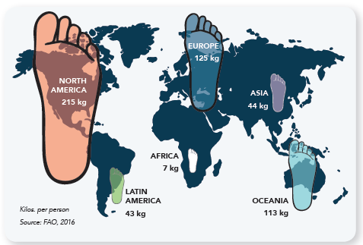
Per capita consumption

Slide 5
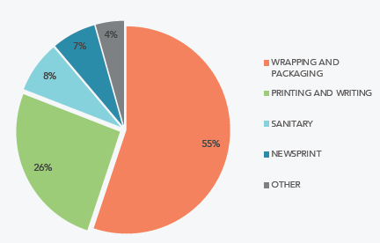
Global paper consumption pattern
Source: PPI

Slide 6
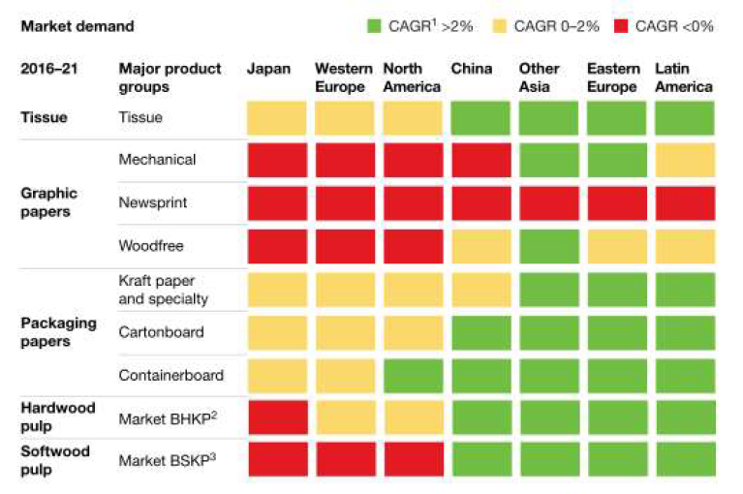
Changing Market Segments….
Market Demand - 2016-21
3

Slide 7
Global Paper & Paperboard Industry
 | CAGR, % (1992-2007) | CAGR, % (2010-2016)
Others | 0.6 | 1.2
Tissue | 3.9 | 3.5
Newsprint | 1.1 | -5.6
Printing & Writing | 3.2 | -1.5
Carton Board | 3.3 | 2.2
Container Board | 4.3 | 2.5

Slide 8
Indian Paper Industry
 | 2016-17 | 2017-18
Total Installed Capacity | 25.55 | 26.28
Operational Capacity | 20.65 | 20.95
Production | 16.91 | 19.00*
Consumption | 20.21 | 21.40**
Import | 4.31 | 3.72
Export | 1.01 | 1.32
*CPPRI estimates, being updated with IPPTA to the tune of 22-23 million tons
**(Production+Import)-Export
Source: CPPRI data base

Slide 9
Indian Paper Industry – Overview
Number of mills |  |  |  | 859
Total Installed capacity, million tons |  |  |  | 25.55
Operating mills |  |  |  | 498
CONTRIBUTION FROM DIFFERENT SEGMENTS
WOOD BASED (18) | AGRO BASED (40) |  | RCF MILLS (440)
19% | 10% |  | 71%
Per capita Consumption, kg |  |  | 14.5
CONTRIBUTIONS ( Rs in Crore)
Total Turnover of the Sector |  | Contribution to Exchequer
60000 |  | 5500
EMPLOYMENT DATA (MILLION PEOPLE)
Direct Employment |  | Indirect Employment
0.6 |  | 1.6
Indian Share in World’s Production, % |  | 4.3

Slide 10
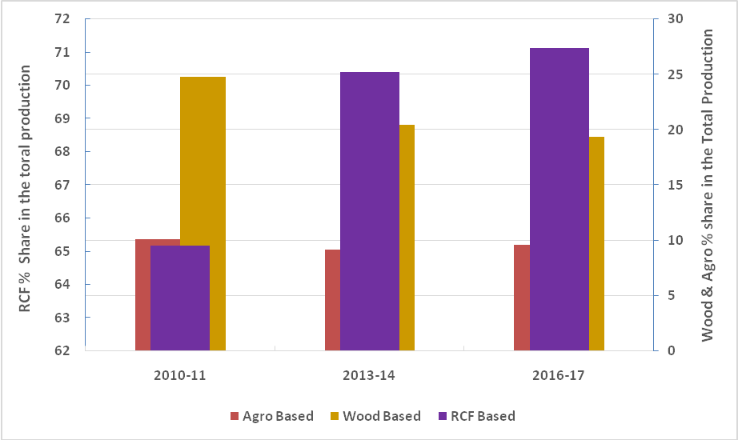
Sectoral Growth – Previous 6 years
RCF based mills- increase from 64% to 71%
Wood based mills- drop from 25% to 19%
Over the last 6 years, the major rise can be seen in the use of recycled fiber (RCF), largely due to environmental issues.

Slide 11
Production and Consumption
In Million Tons

Slide 12
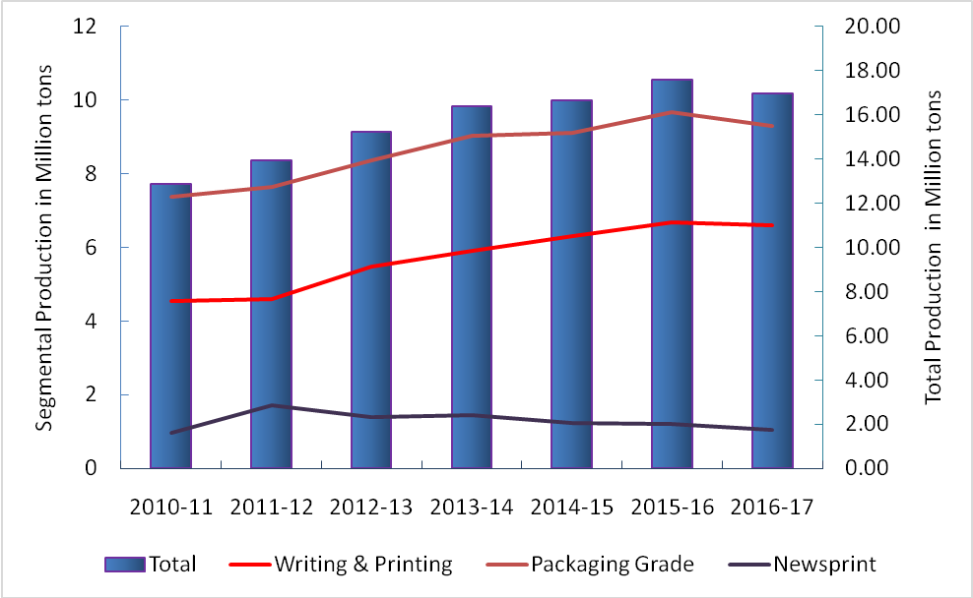
Variety wise Production Trends
While packaging grades indicated the highest growth, Newsprint showed a downward trend.

Slide 13
Major Issues & Challenges
Despite a positive demand outlook, there are several barriers to the growth of the paper Industry. Some of them are –
Raw material constraints
Cost of basic input
Low scale of Operation and Obsolete Technologies
Environmental Concerns
Lack of Skilled manpower

Slide 14
Raw material constraints
Inadequate availability and good quality of raw materials.
Dependence on a mixed source of raw materials consisting of wood, agro residues and recycled fibres.
Limited supplies leading to dependence on imported pulp, wood chips and waste paper.
Due to depleting forest cover, the supply of wood has further declined. Government regulations on captive plantation by the Industry also restrict the use of degraded forest lands for plantation of pulpable species of trees.

Slide 15
Availability of Agro Residues
The availability of agro residues is affected by cycles in agricultural produce. Other factors limiting their availability for paper Industry include:
Utilization of bagasse as an alternative fuel in sugar industry.
Recovering 75% wheat straw due to prevailing harvesting mechanism.
High cost of transportation of loose straw.

Slide 16
Availability of Waste Paper
Availability of indigenous waste paper is poor as most of the post-consumed paper finds alternate use as in packaging.
Waste paper recovery rate in India is as low as 35% compared to 55% - 60% in developed nations.
Further in the absence of an effective waste paper collection, sorting and grading system, the quality of waste paper is inferior.
The Paper Industry relies on waste paper imports to meet its demand of waste paper.

Slide 17
Cost of basic input
Production WPP from Wood | Indian mill (%) | European mill (%)
Raw material | 57 | 40
Power & Fuel | 15 | 13
Personnel | 9 | 14
Other manufacturing expenses | 19 | 33

Slide 18
Low scale of Operation and Obsolete Technologies
The Indian paper industry is highly fragmented predominately consisting of small / medium scale units based on recycled paper & agro residue fibres.
Only 174 mills have capacities over 100 TPD, around 426 mills in India have installed capacities ranging from 5-50 TPD.
The capital to turnover ratio in Indian Paper Industry is low (3:1) as compared to 1:1 in Cement Industry due to obsolete technologies in majority of paper mills.

Slide 19
Environmental Concerns
High effluent load
High color load
Black liquor management in small agro based mills
Solid waste management
Concern over air pollution with growing public awareness

Slide 20
Lack of Skilled Manpower
The industry is facing shortage of process stream technical manpower.
Only 226 number of process technical manpower are passing out every year from 7 institutes against a demand of over 570 per annum.

Slide 21
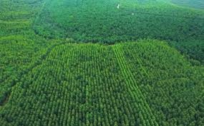
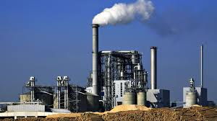
Innovation in Paper & Paperboard Manufacturing
Process Technology
Automation and Control
Ecosystem
State-of-Art fiberline and paper machines
Data collection, analysis and guidance
Environmental compliance -process & product
Optimisation of processes and product quality

Slide 22
Conclusion
A structured, strategic and time bound plan is required to address the issues and challenges faced by the paper industry.
Industry needs to take-up the issues with Government in this regard, through appropriate policy interventions.

Slide 23
Committed towards growth and sustainability of paper industry….
Thank you

